Slide 1

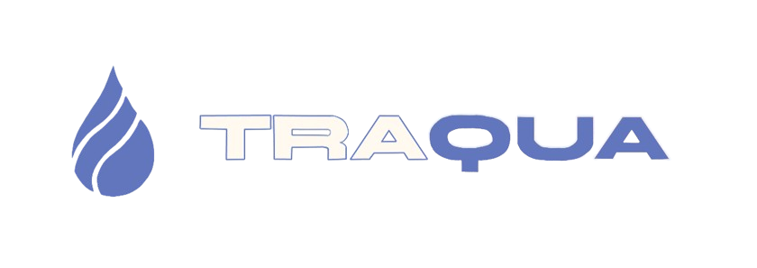


INTERIM REPORT
16/04/2026

Slide 2

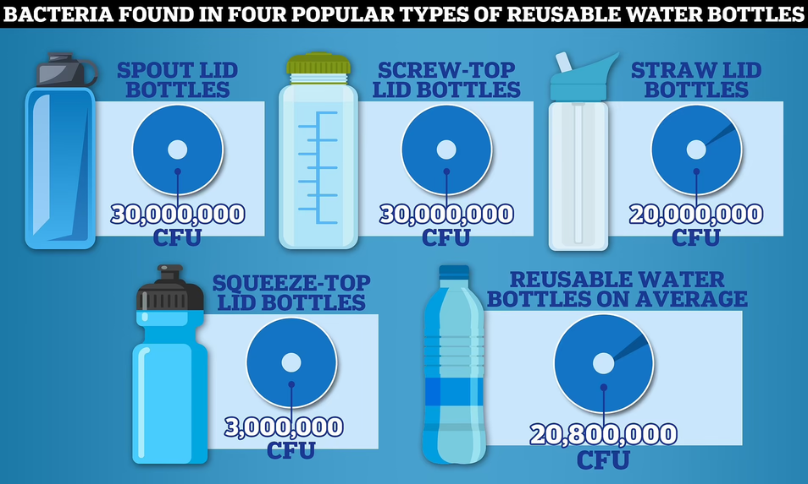
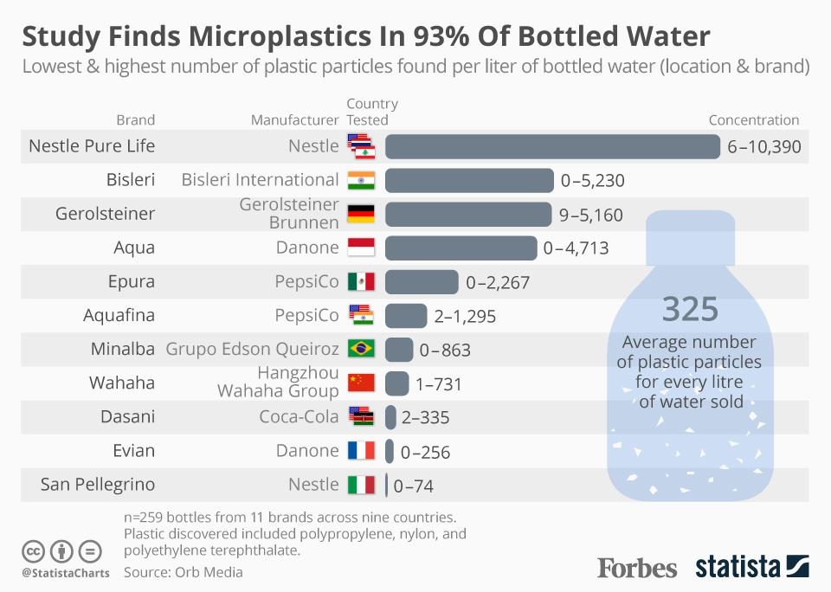
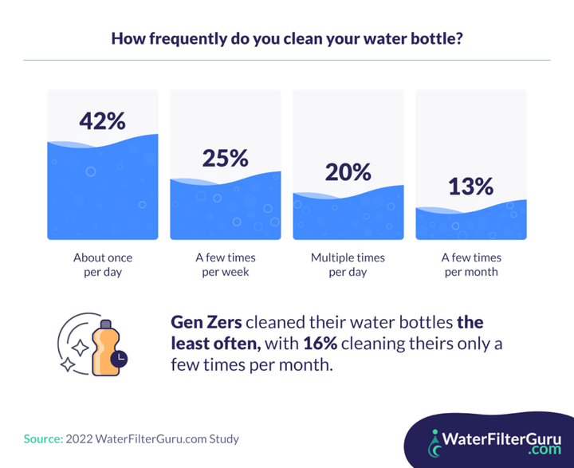
INTERIM REPORT
16/04/2026
Problem Statement
2

Slide 3
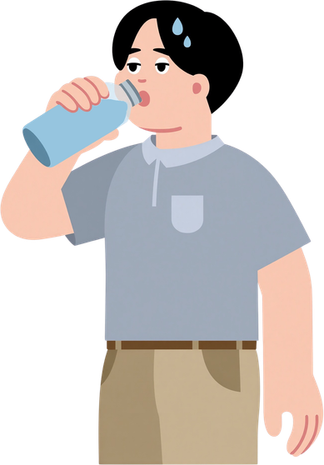
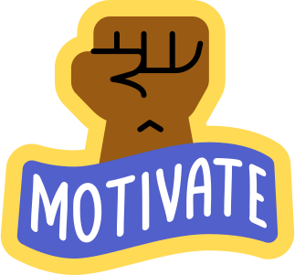
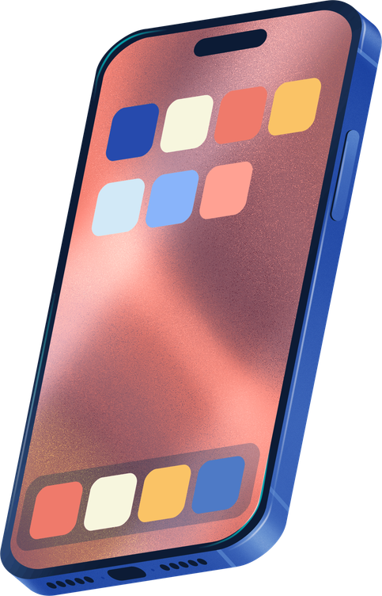
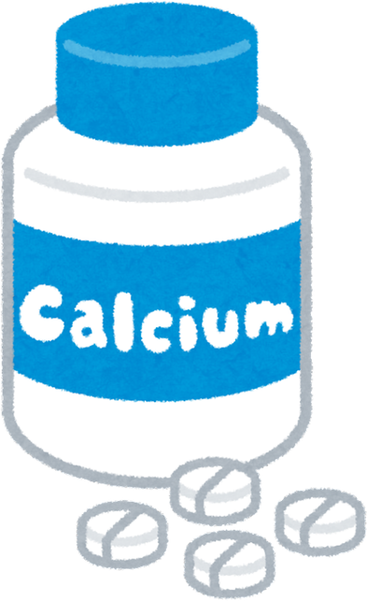
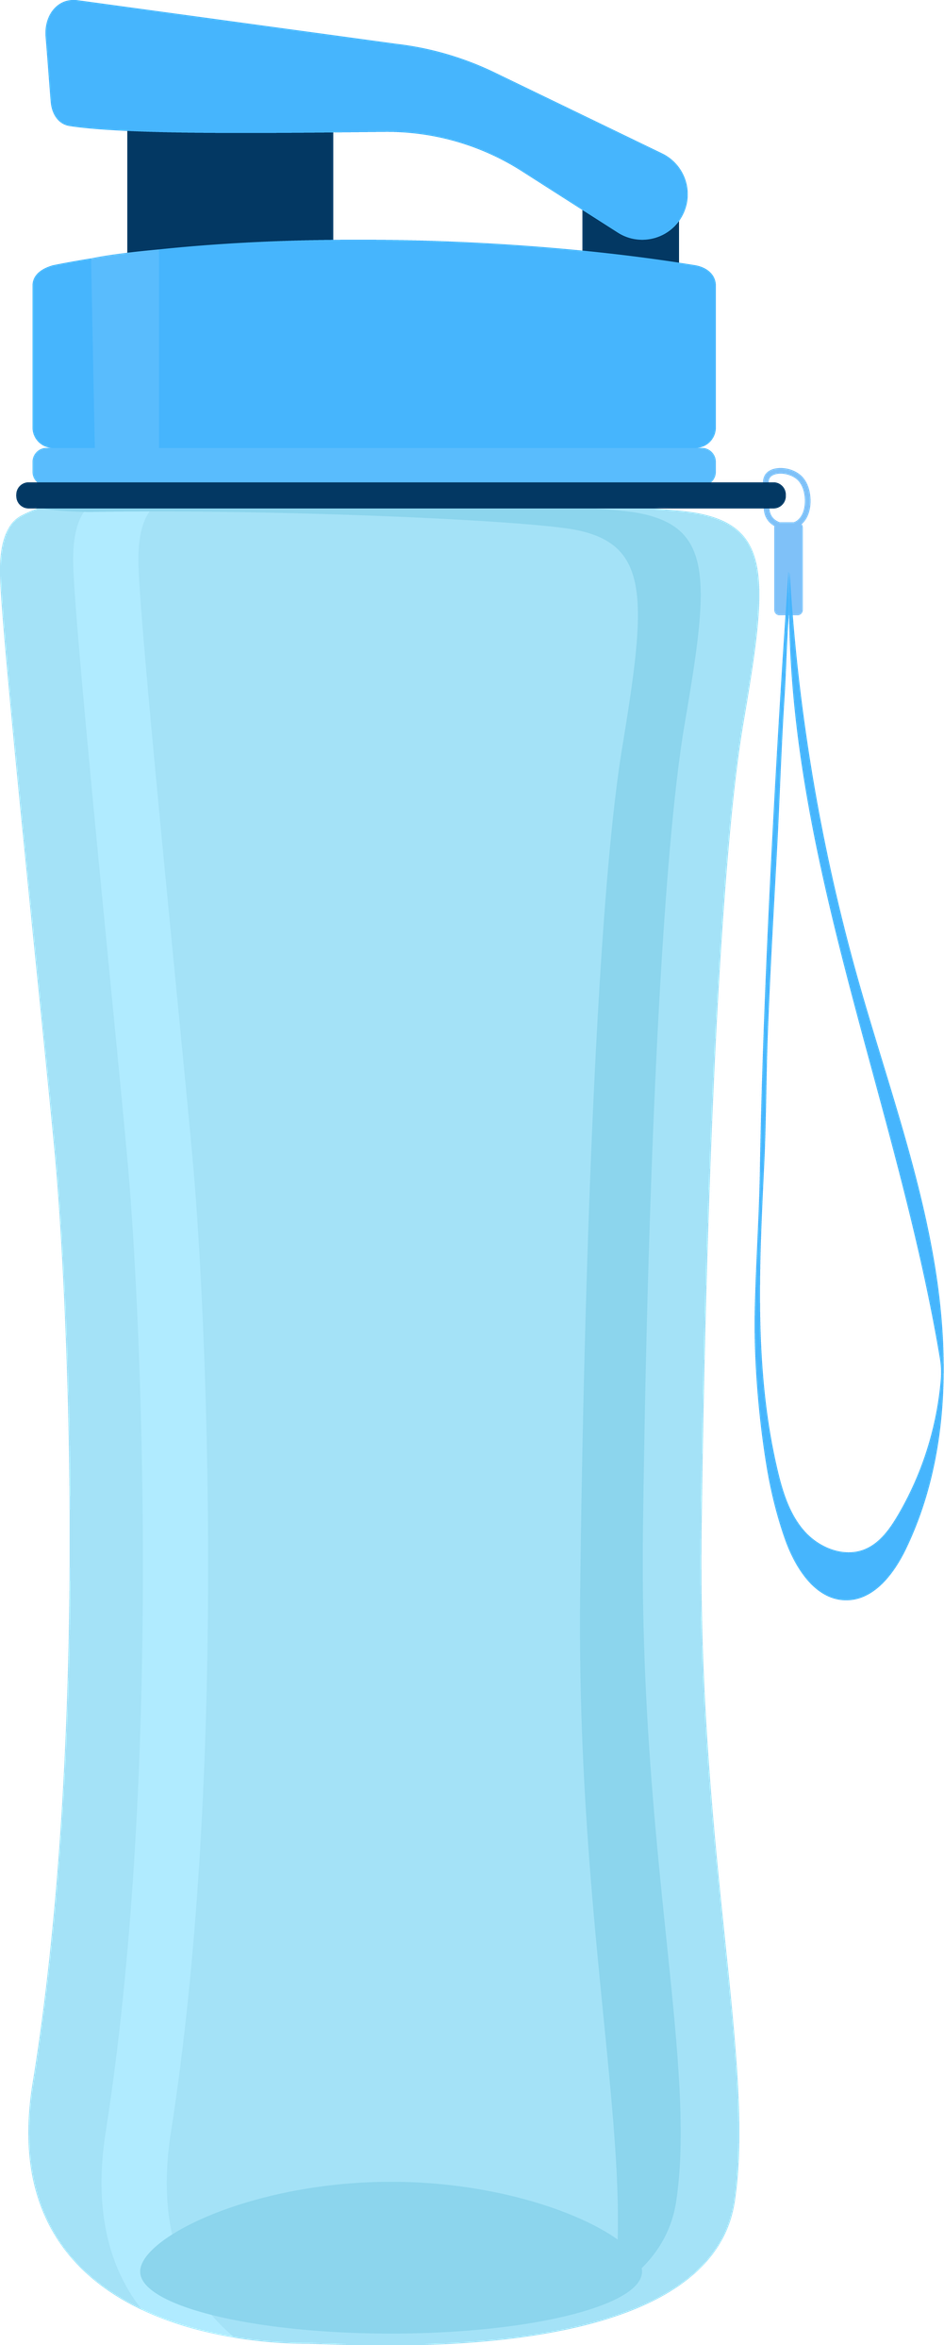

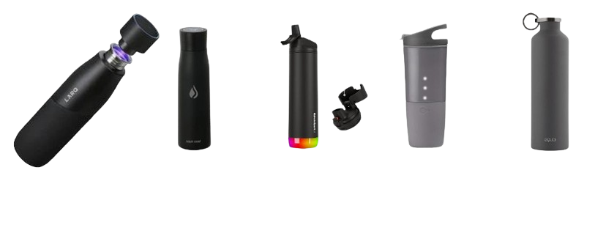

INTERIM REPORT
16/04/2026
State of the Art
  Tracking + reminders support water intake
  Electrolyte balance, temperature regulation
  Quantity, quality and how regulary
Hydration:
Effects
of tracking:
Minerals:
  Keep electrolyte balance stable
Hygiene:
  20 % of bottles with a risky level of microorganism
  UV-C kills 99 % of bacteria
3

Slide 4

INTERIM REPORT
16/04/2026
Marketing Plan
Know your water. Trust your bottle.
  Active people
  Health Enthusiasts & Eco-Conscious Professionals
  Premium pricing: ~ 250 € retail + app subscription model
  Distributed via official website, Amazon & premium retail stores
  Promoted through university pilot, social media & fitness influencers
  Gamification features drive daily engagement and retention
4

Slide 5
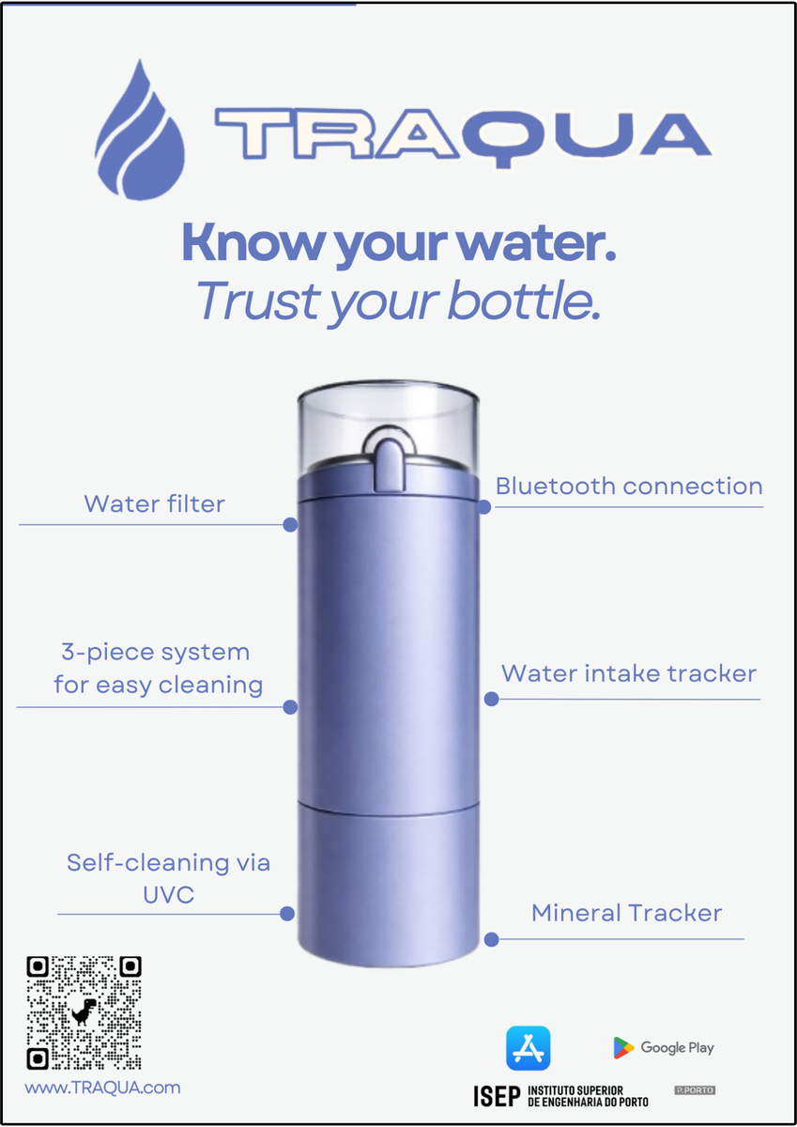
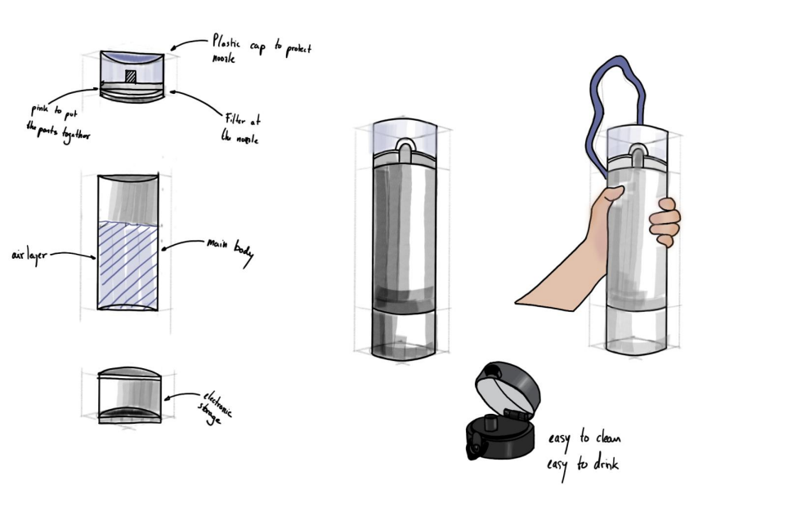
INTERIM REPORT
16/04/2026
Solution
5

Slide 6
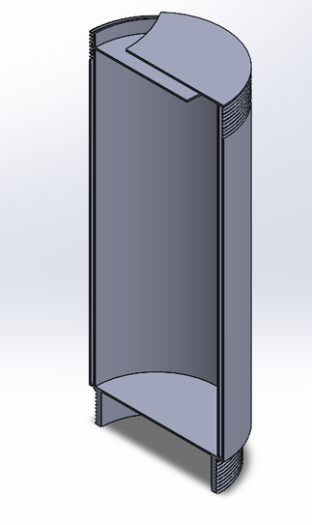
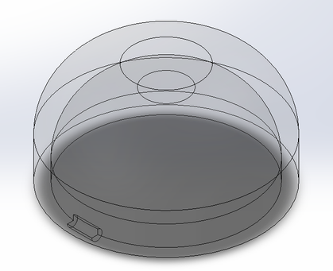
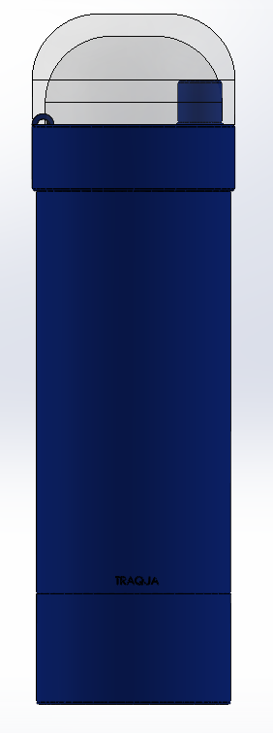
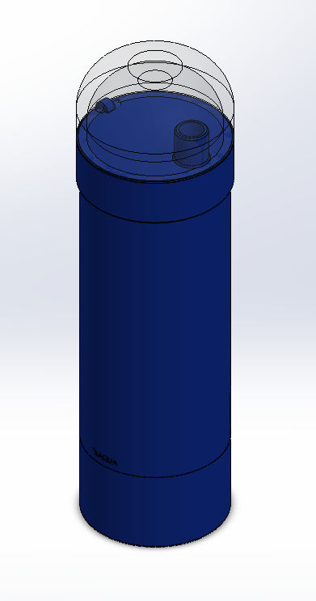
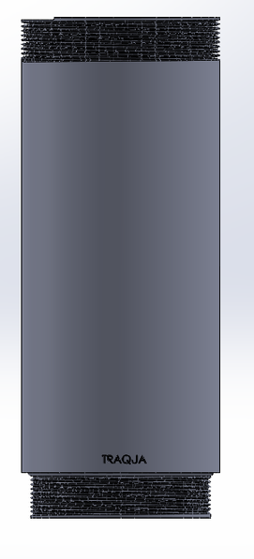
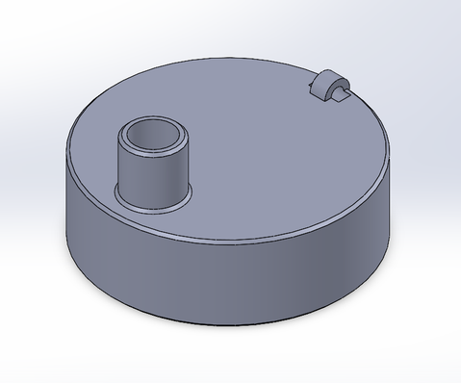
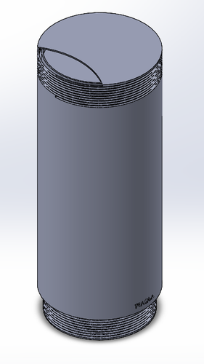
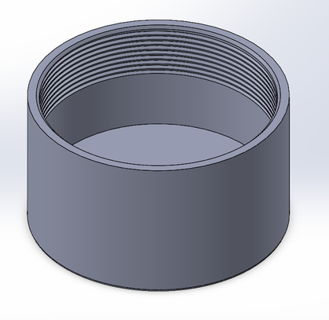
INTERIM REPORT
16/04/2026
Structural drawings
6

Slide 7
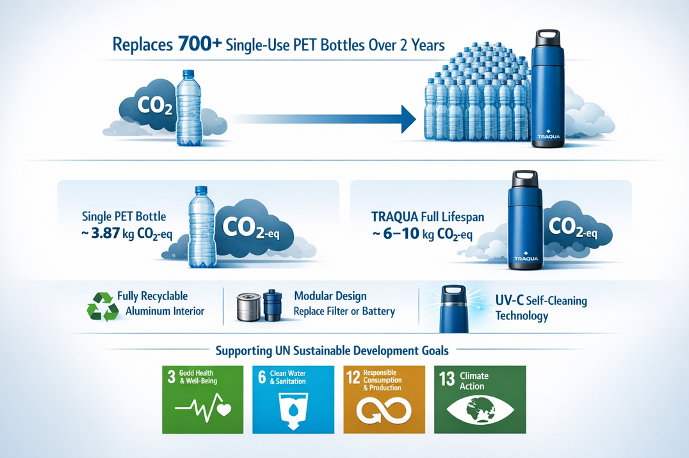
INTERIM REPORT
16/04/2026
Sustainability
  More sustainable way to drink water
  Replace single-use plastic bottle
  Durable and recyclable materials
  Repairable
  Impact from electronics & aluminium
  Production impact
=> Long-life design & behavior change
7

Slide 8
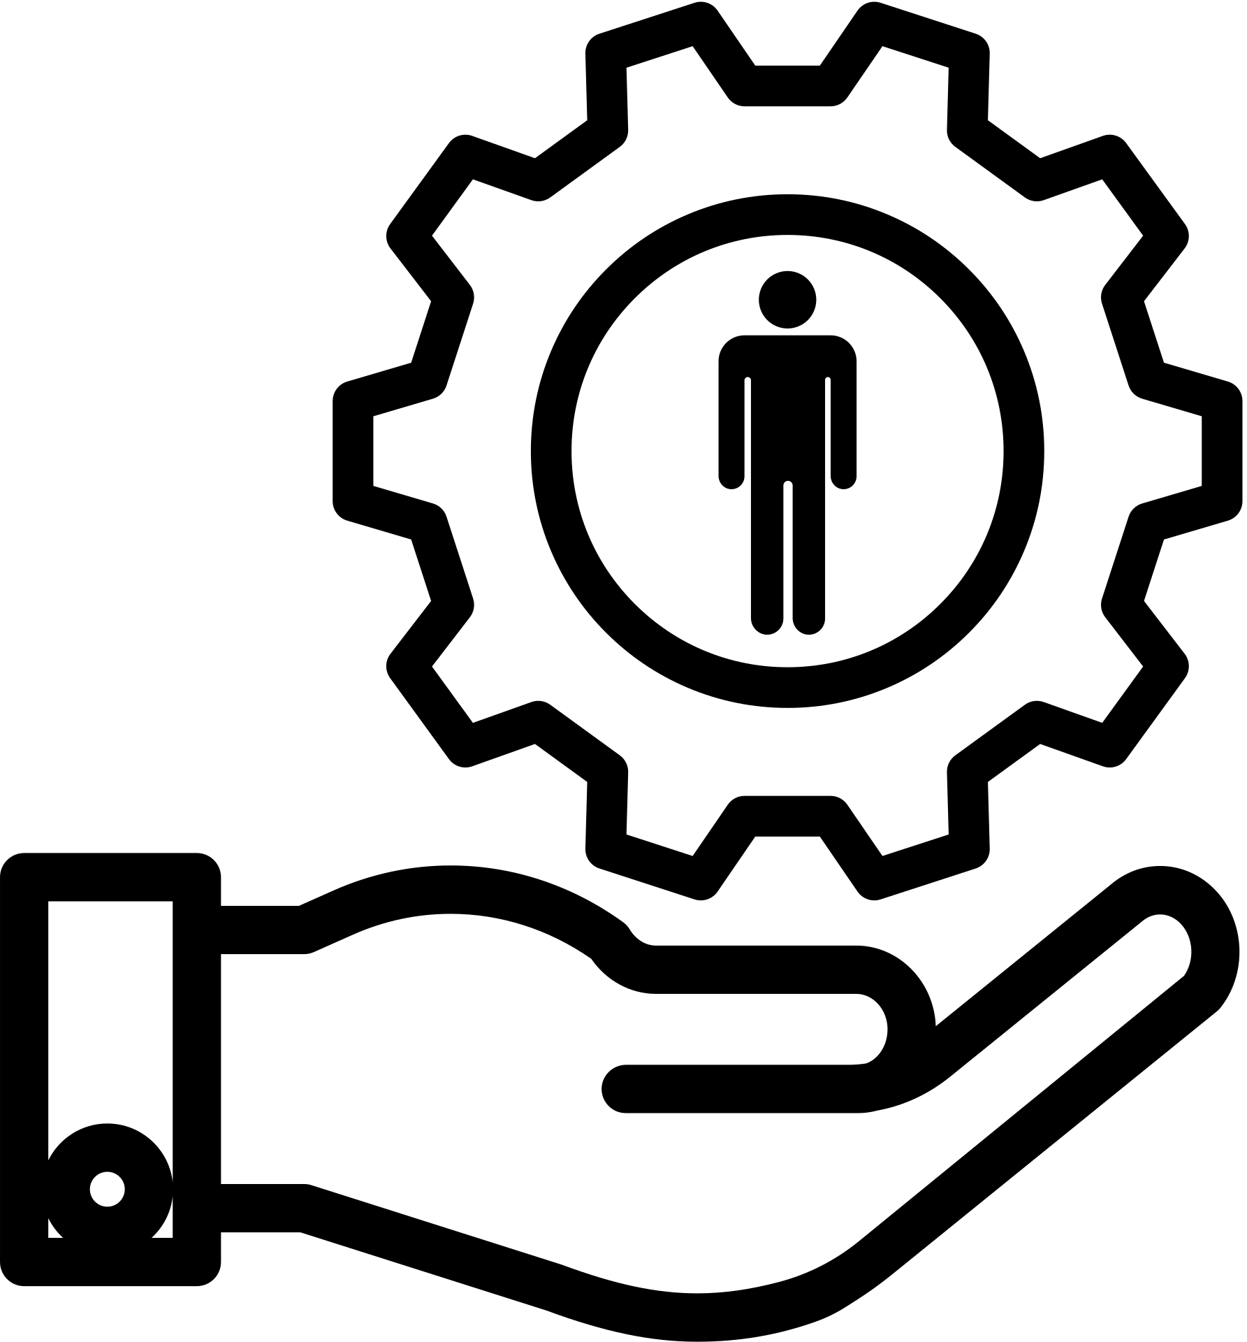


INTERIM REPORT
16/04/2026
Ethics
Engineering ethics
  Safety: UV-C, foodsafe
  Communication, transparency
Marketing ethics
  Responsible sales
  Fair pricing
  Honest branding
Environmental ethics
  Ecological balance
  Avoid greenwashing
8

Slide 9
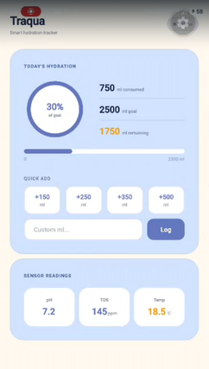
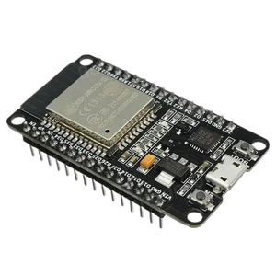

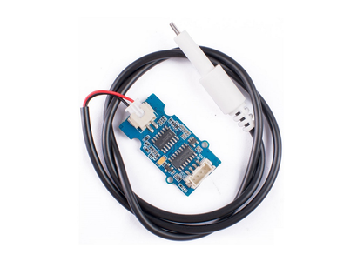
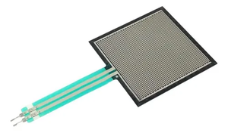
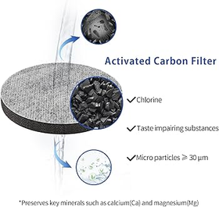
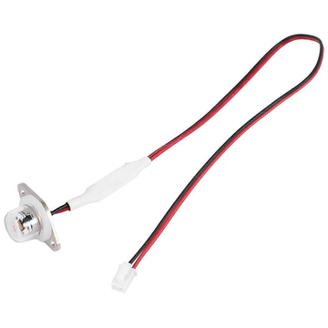
INTERIM REPORT
16/04/2026
Smart system
TRACK
App for constant reminders and daily goals
MEASURE
Measure the amount of water consumed & quality
CLEAN
UV-C bottle cleaning & water filtering
9

Slide 10
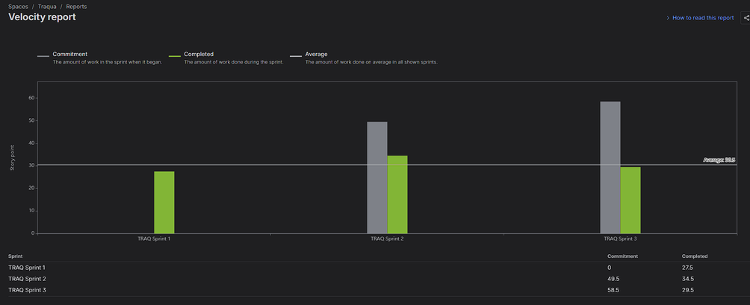
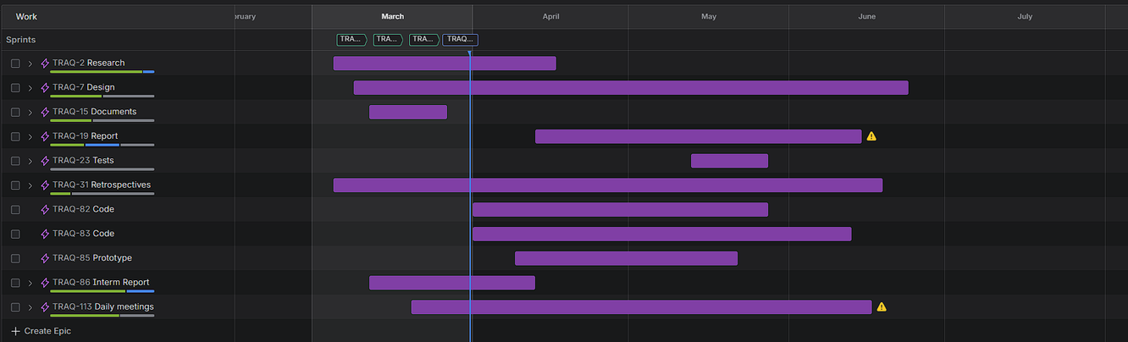
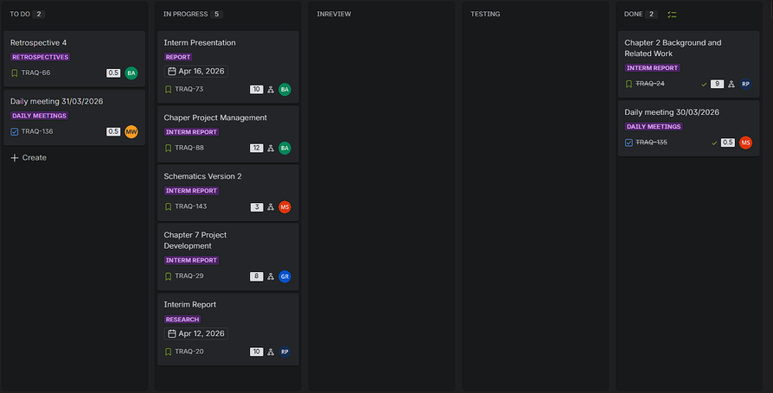
INTERIM REPORT
16/04/2026
Project Management
10

Slide 11
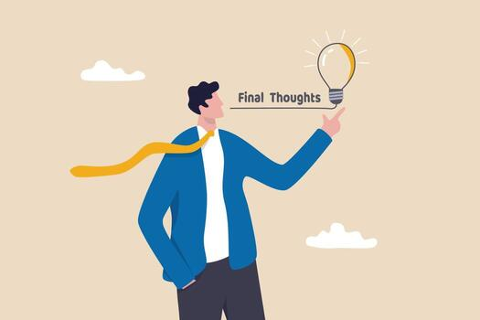
INTERIM REPORT
16/04/2026
Conclusion
  Clear problem-solution fit
  Strong marketing plan
  Practical and feasible design
  Focus on sustainability
  Consideration of engineering, marketing and environmental ethics
  Integrated smartsystem (Measure, Track & Clean)
  Solid project management
Questions?
11

