Slide 1




FINAL PRESENTATION
18/06/2026

Slide 2

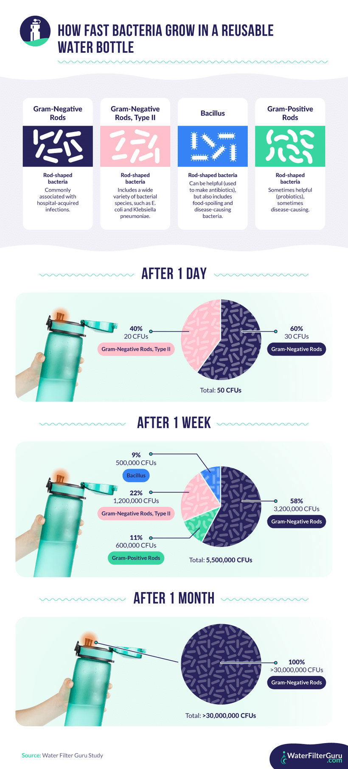
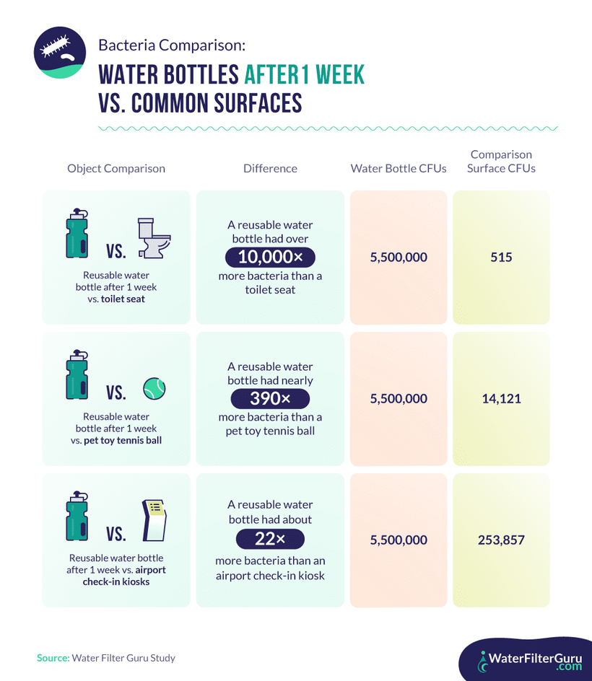
FINAL PRESENTATION
18/06/2026
Problem Statement
2

Slide 3
FINAL PRESENTATION
18/06/2026
Agenda
  Solution
  Marketing
  Materials
  Prototype
  Outcome
  Future Developement
  Q&A
3

Slide 4
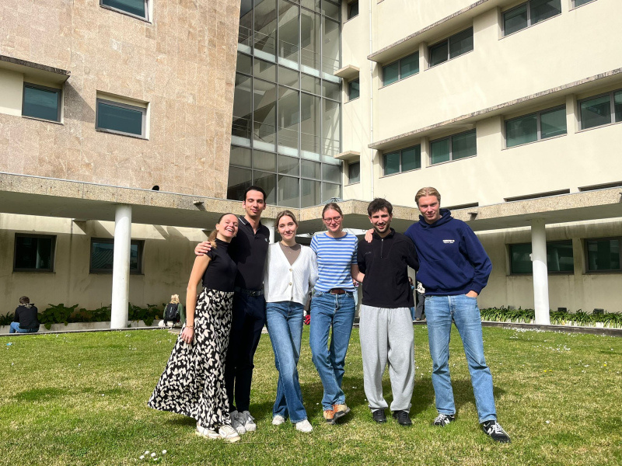
FINAL PRESENTATION
18/06/2026
TRAQUA Team
Ines, Bernardo Maria, Rieke, Guillem, Maximilian

Slide 5

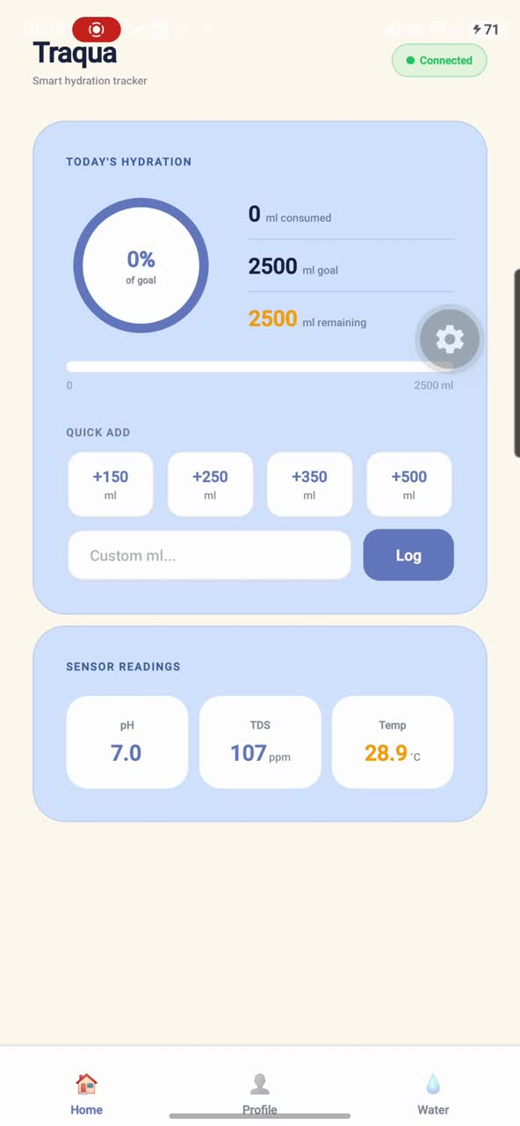





FINAL PRESENTATION
18/06/2026
Solution
UVC-Sterilisation
Hydration tracking
Mineral Tracking
Filtration
Real-time Analysis, Personalized App, Smart reminders
5

Slide 6
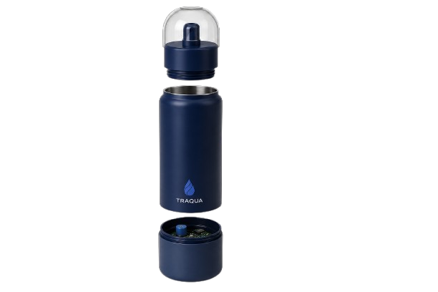
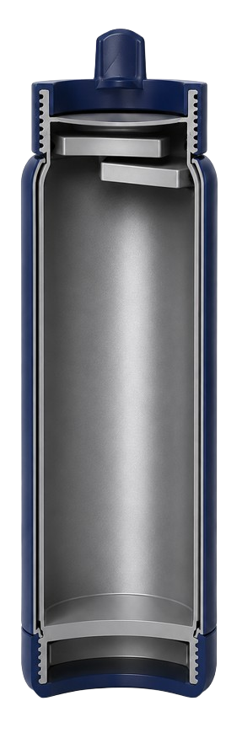

FINAL PRESENTATION
18/06/2026
Solution
Three main parts
Modern and ergonomic shape for everyday use
Dual protection against UV-C radiation
Sustainable material selection
Long-lasting and replaceable electrical components
Smart system to ensure durability and waterproofing
6

Slide 7
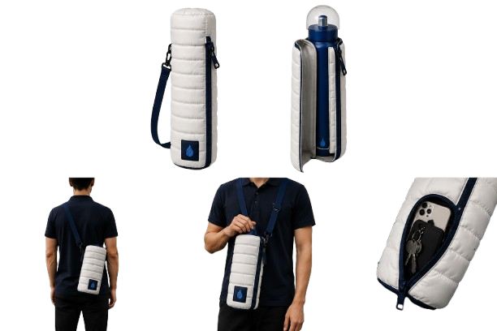
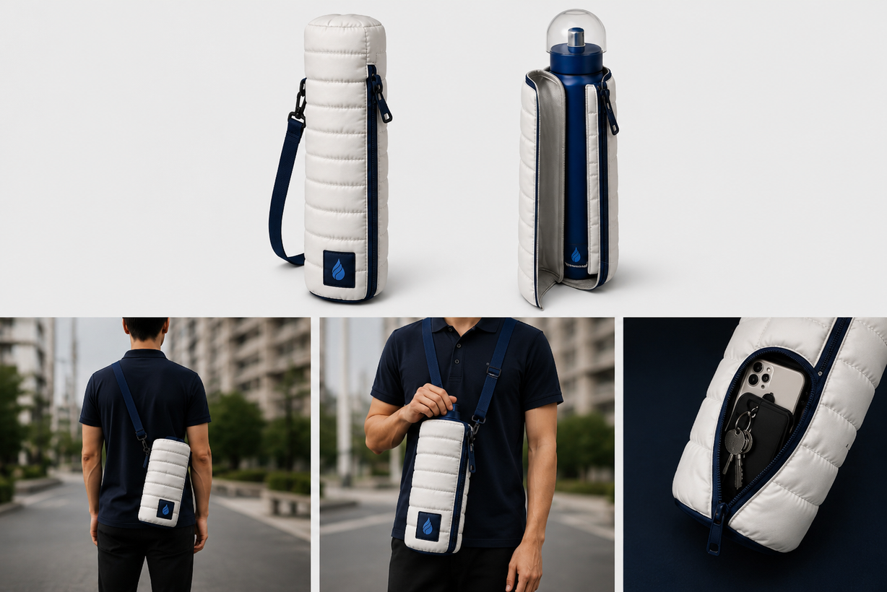
FINAL PRESENTATION
18/06/2026
Solution: Packaging
7

Slide 8

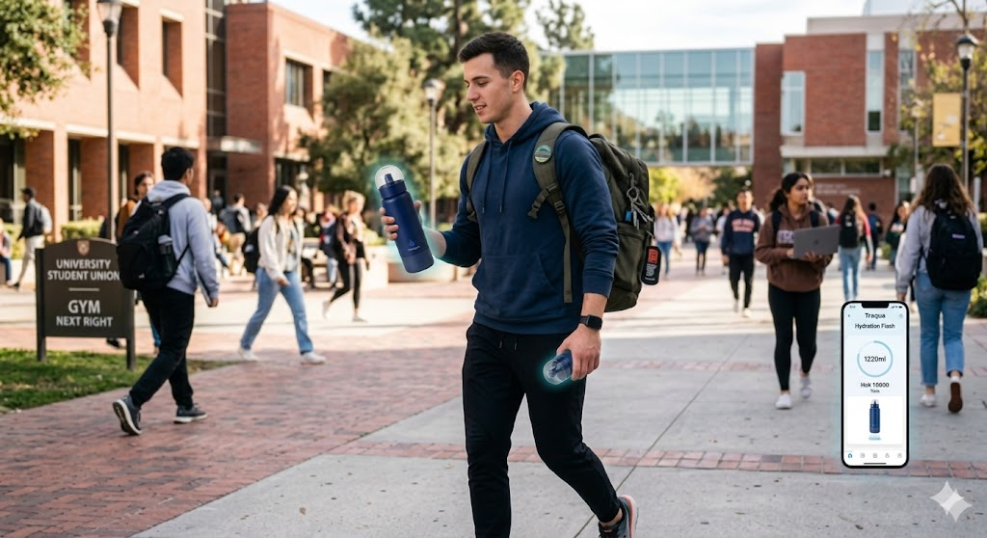

FINAL PRESENTATION
18/06/2026
Solution : Target group
Lifestyle: Active, busy, travelling
Behaviours: Usage of apps to track health and productivity, open to a new technologies
Needs: reliable and easy hydration, water safety, and reduce cleaning of the bottle
Values: Health, sustainability, efficiency, and modern design
8

Slide 9
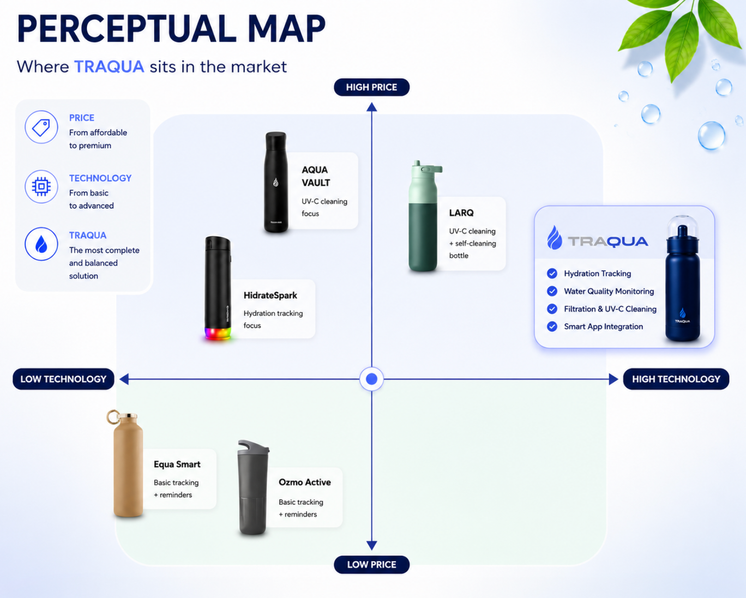




FINAL PRESENTATION
18/06/2026
Marketing
Highest level of technology
  Combines multiple functionalities
  Premium market positioning
  Differentiated from competitors
9

Slide 10

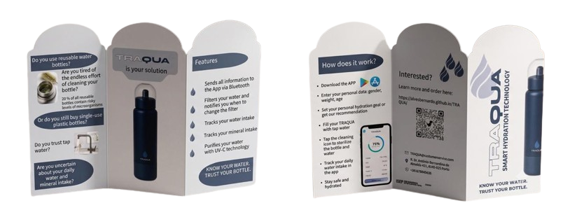

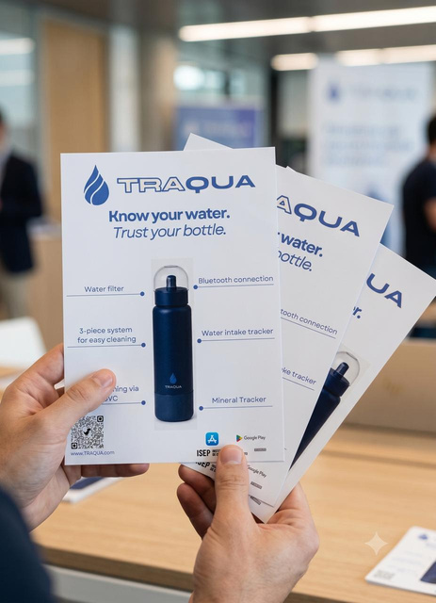
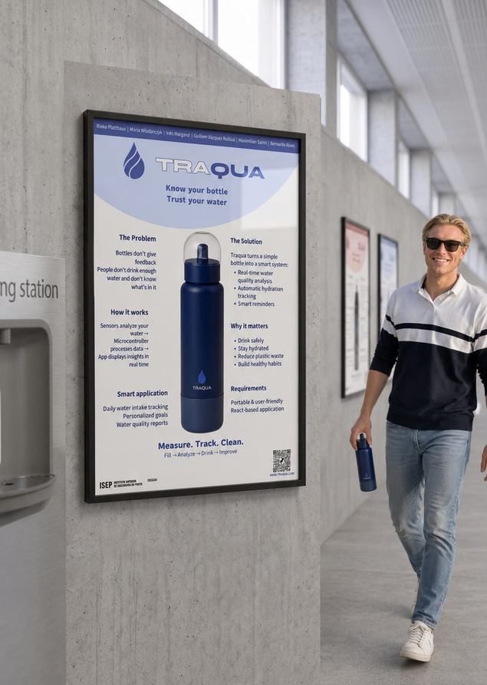

FINAL PRESENTATION
18/06/2026
Materials
Leaflet
Flyer
User Manual
Poster
10

Slide 11
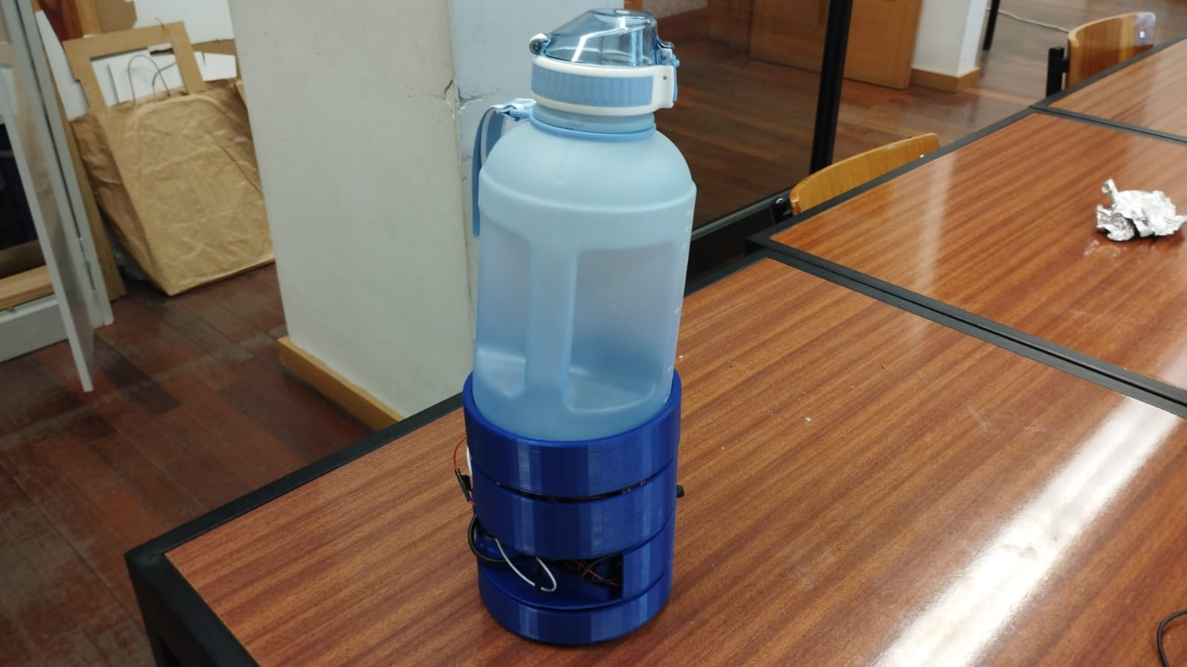
FINAL PRESENTATION
18/06/2026
Prototype development
  3D-printed electronic base (PLA), houses sensors + battery
  FSR sensor
  UV-C LED wired in
  Fully assembled, functional unit
11

Slide 12
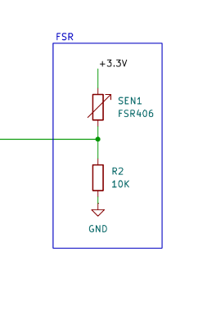
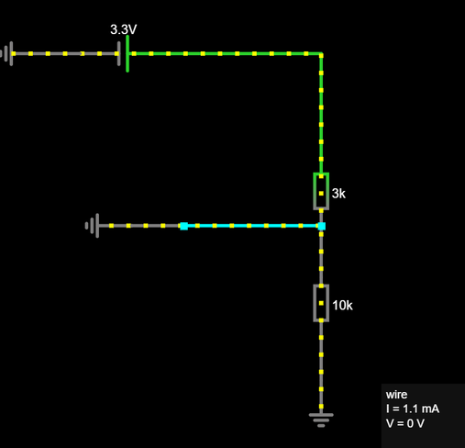
FINAL PRESENTATION
18/06/2026
Prototype testing
The prototype was tested using following methods:
Theoretical
Simulation
Functional testing
12

Slide 13
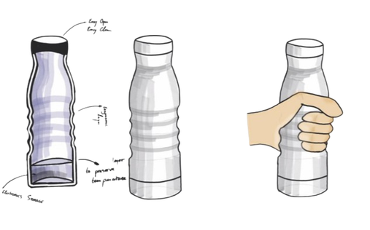
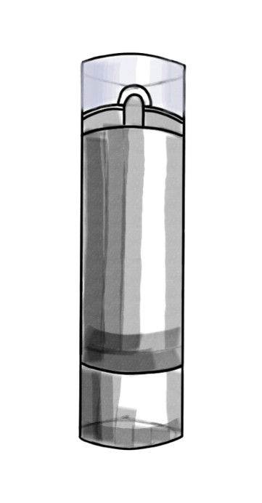
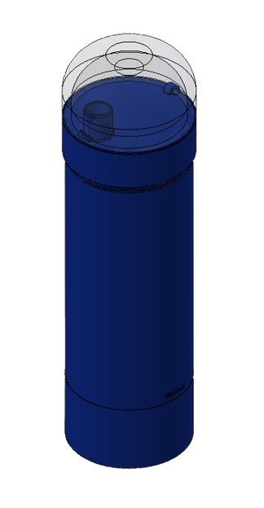
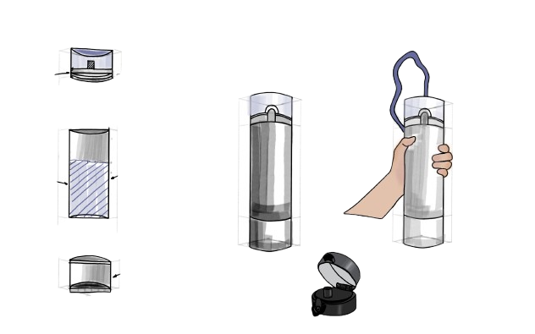
FINAL PRESENTATION
18/06/2026
Outcomes
Now
13

Slide 14
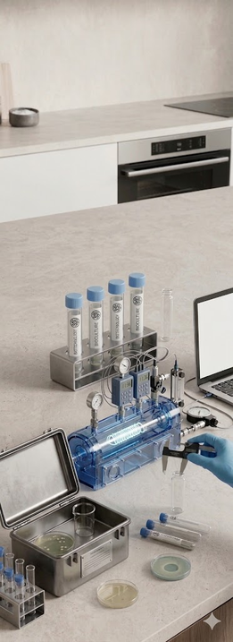
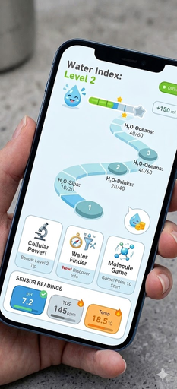

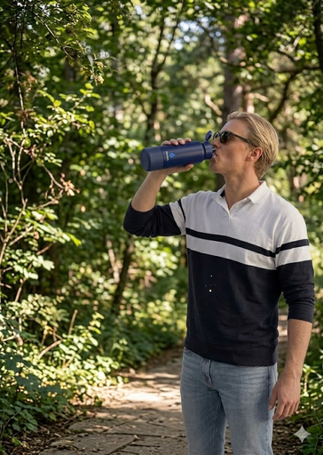
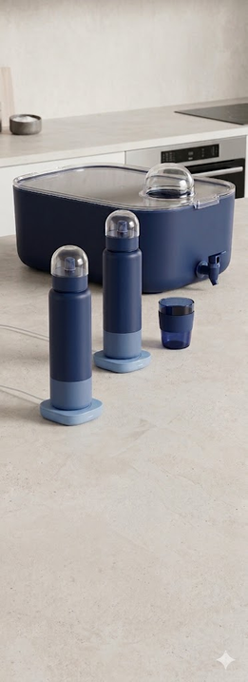
FINAL PRESENTATION
18/06/2026
Now
Future Development
App modification:
Gamification,
improved health profile
Premium models
Testing
Different sizes,
Cost-reduced models
different features
14

Slide 15

FINAL PRESENTATION
18/06/2026
Visit us here
15

Slide 16
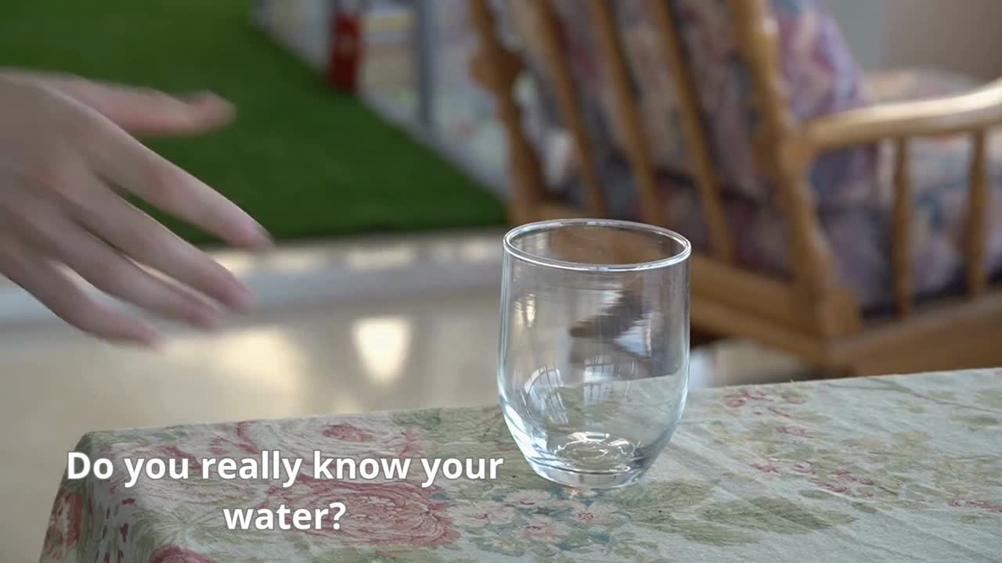
16

